Slide 1
Chapter 3: Information Representation
Binary Numbers
Notes:
In this presentation, we will look at binary number representation at more detail.

Slide 2
Decimal to Binary Conversions
Binary numbering system
Difficult to read long strings of binary numbers
For example: 11010100011011₂ = 13595₁₀
Binary values expressed using hexadecimal
Hexadecimal numbering system
Uses numerals 0 through 9 and letters A through F
Decimal number 12 is C₁₆.
Decimal number 26 is 1A₁₆.
Easy to convert between base 16 and base 2
Because 16 = 2⁴.
Group binary digits into groups of four to convert from binary to hexadecimal
A group of four binary digits is called a hextet
Notes:
The binary or base 2 numbering system is the most important radix system for digital computers.
However, it is difficult to read long strings of binary numbers-- and even a modestly-sized decimal number becomes a very long binary number.
For example: 11010100011011₂ = 13595₁₀
For compactness and ease of reading, binary values are usually expressed using the hexadecimal, or base-16, numbering system.
The hexadecimal numbering system uses the numerals 0 through 9 and the letters A through F.
The decimal number 12 is C₁₆.
The decimal number 26 is 1A₁₆.
It is easy to convert between base 16 and base 2, because 16 = 2⁴.
Thus, to convert from binary to hexadecimal, all we need to do is group the binary digits into groups of four.
Did you know that a group of four binary digits is call a hextet.

Slide 3
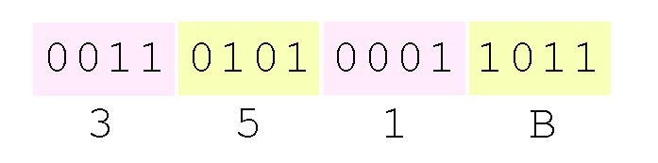
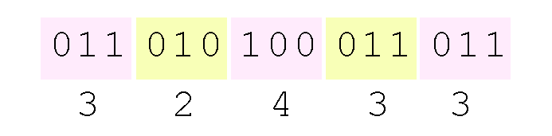
Decimal to Binary Conversions
Group by hextets to convert binary number 11010100011011₂ (= 13595₁₀) into hexadecimal:
Octal (base 8) values are derived from binary by using groups of three bits (8 = 2³):
Octal was useful when computers used six-bit words
Notes:
As we can see here, Using groups of hextets, the binary number 11010100011011₂ (= 13595₁₀) can be easily converted to hexadecimal
Octal (base 8) values are derived from binary by using groups of three bits because 8 = 2³
Octal was useful when computers used six-bit words

Slide 4
Signed Integer Representation
Negative values - high-order bit indicates the sign
High-order bit is the leftmost bit in a byte
High-order bit is called the most significant bit
Remaining bits contain the value of the number
Three ways to express signed binary:
Signed magnitude
One’s complement
Two’s complement
Notes:
The conversions we have so far presented have involved only positive numbers.
To represent negative values, computer systems allocate the high-order bit to indicate the sign of a value.
The high-order bit is the leftmost bit in a byte. It is also called the most significant bit.
The remaining bits contain the value of the number.
There are three ways in which signed binary numbers may be expressed:
Signed magnitude,
One’s complement and
Two’s complement.
Let’s look at each one of these.

Slide 5
Signed Integer Representation
Signed magnitude for 8-bit word
absolute value of number in the 7 right
Example: 8-bit signed magnitude
Positive 3 is: 00000011
Negative 3 is: 10000011
Computers perform arithmetic operations on signed magnitude
ignore signs of the operands while performing a calculation
applying appropriate sign after calculation is complete
Notes:
In an 8-bit word, signed magnitude representation places the absolute value of the number in the 7 bits to the right of the sign bit.
For example, in 8-bit signed magnitude,
positive 3 is: 00000011
Negative 3 is: 10000011
Computers perform arithmetic operations on signed magnitude numbers in much the same way as humans carry out pencil and paper arithmetic.
Humans often ignore the signs of the operands while performing a calculation, applying the appropriate sign after the calculation is complete.

Slide 6
Signed Integer Representation
Binary addition - easy - four rules:
0 + 0 = 0 0 + 1 = 1
1 + 0 = 1 1 + 1 = 10
This system makes it possible for digital circuits to carry out arithmetic operations
We will describe these circuits in later chapters.
Let’s see how the addition rules work with signed magnitude numbers . . .
Notes:
Binary addition is as easy as it gets. You need to know only four rules:
0 + 0 = 0 0 + 1 = 1
1 + 0 = 1 1 + 1 = 10
The simplicity of this system makes it possible for digital circuits to carry out arithmetic operations.
We will describe these circuits in later chapters.
Let’s see how the addition rules work with signed magnitude numbers . . .

Slide 7
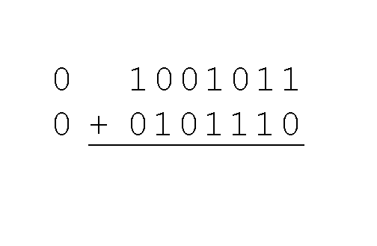
Signed Integer Representation
Example:
Using signed magnitude binary arithmetic
Find the sum of 75 and 46
Step 1
convert 75 and 46 to binary
separate (positive) sign bits from magnitude bits
Notes:
Example:
Using signed magnitude binary arithmetic, find the sum of 75 and 46.
First, convert 75 and 46 to binary, and arrange as a sum, but separate the (positive) sign bits from the magnitude bits.

Slide 8
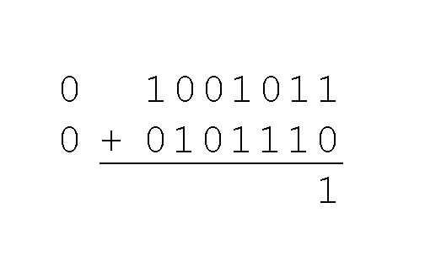
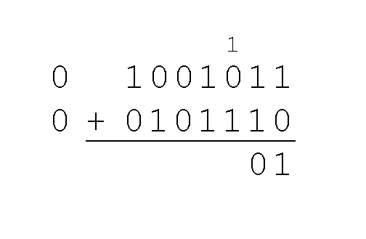
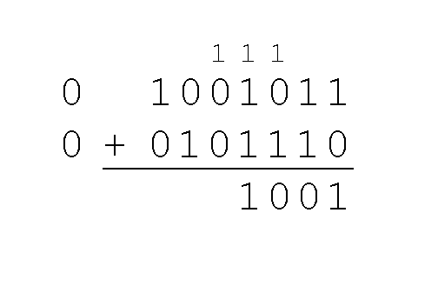
Signed Integer Representation
Step 2
Start with rightmost bit and work left
Step 3
Note carries above next bit
Notes:
Just as in decimal arithmetic, we find the sum starting with the rightmost bit and work left.
In the second bit, we have a carry, so we note it above the third bit.
The third and fourth bits also give us carries.

Slide 9
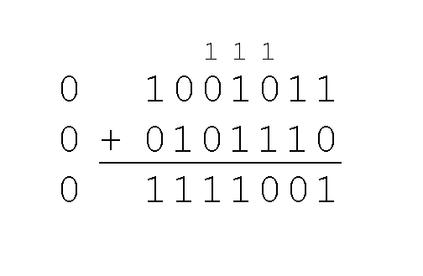
Signed Integer Representation
Example…
Using signed magnitude binary arithmetic
Find the sum of 75 and 46
Worked through all eight bits
In this example, the two values sum fit into seven bits.
If that is not the case, this needs additional methods.
Notes:
Once we have worked our way through all eight bits, we are done.
In this example, we were careful to pick two values whose sum would fit into seven bits. If that is not the case, we have a problem. Additional methods will be needed.

Slide 10
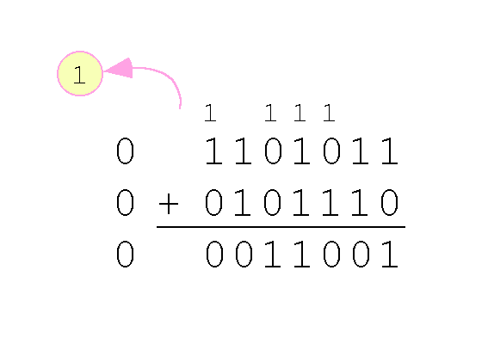
Signed Integer Representation
Example:
Using signed magnitude binary arithmetic
Find the sum of 107 and 46
Carry from the seventh bit
overflows and is discarded
erroneous result: 107 + 46 = 25
Notes:
Let’s look at another example:
Using signed magnitude binary arithmetic
Find the sum of 107 and 46
We see that the carry from the seventh bit overflows and is discarded, giving us the erroneous result: 107 + 46 = 25.

Slide 11
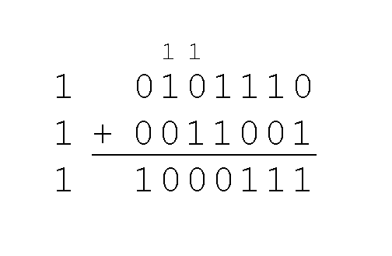
Signed Integer Representation
Signs in signed magnitude representation
Example:
Using signed magnitude binary arithmetic
Find the sum of - 46 and – 25
Signs are the same
Add the numbers
Supply negative sign when done
Notes:
The signs in signed magnitude representation work just like the signs in pencil and paper arithmetic.
Example: Using signed magnitude binary arithmetic, find the sum of - 46 and - 25.
Because the signs are the same, all we do is add the numbers and supply the negative sign when we are done.

Slide 12
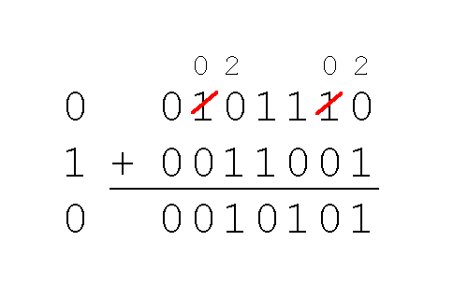
Signed Integer Representation
Mixed sign addition (or subtraction) is done the same way.
Example:
Using signed magnitude binary arithmetic
Find the sum of 46 and - 25
Sign of result gets sign of number with larger absolute value
Note “borrows” from second and sixth bits
Notes:
Mixed sign addition (or subtraction) is done the same way.
Example: Using signed magnitude binary arithmetic, find the sum of 46 and - 25.
The sign of the result gets the sign of the number that has the larger absolute value.
Note the “borrows” from the second and sixth bits.

Slide 13
Signed Integer Representation
Signed magnitude representation
Easy for people to understand
Requires complicated computer hardware
Another disadvantage of signed magnitude
Allows two different representations for zero
positive zero
negative zero
Computers systems employ complement systems for numeric value representation
Notes:
Signed magnitude representation is easy for people to understand, but it requires complicated computer hardware.
Another disadvantage of signed magnitude is that it allows two different representations for zero: positive zero and negative zero.
For these reasons (among others) computers systems employ complement systems for numeric value representation.

Slide 14
Signed Integer Representation
Complement systems
Negative values are represented by some difference between a number and its base
Diminished radix complement systems
Negative value is given by the difference between the absolute value of a number and one less than its base
Binary system - one’s complement
Flip the bits of a binary number
Notes:
In complement systems, negative values are represented by some difference between a number and its base.
In diminished radix complement systems, a negative value is given by the difference between the absolute value of a number and one less than its base.
In the binary system, this gives us one’s complement. It amounts to little more than flipping the bits of a binary number.

Slide 15
Signed Integer Representation
Example - in 8-bit one’s complement
Positive 3 is: 00000011
Negative 3 is: 11111100
One’s complement
Negative values are indicated by a 1 in the high order bit
Complement systems
Eliminate the need for subtraction
Difference of two values is found by adding
Notes:
For example, in 8-bit one’s complement, positive 3 is: 00000011
Negative 3 is: 11111100
In one’s complement, as with signed magnitude, negative values are indicated by a 1 in the high order bit.
Complement systems are useful because they eliminate the need for subtraction. The difference of two values is found by adding the minuend to the complement of the subtrahend.

Slide 16
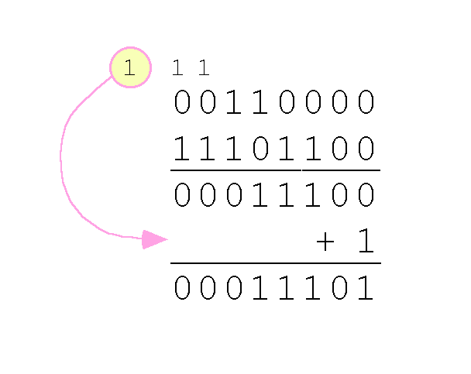
Signed Integer Representation
One’s complement addition
Carry bit is “carried around” and added to the sum
Example:
Using one’s complement binary arithmetic
Find sum of 48 and – 19
Note:
19 in one’s complement is 00010011
-19 in one’s complement is 11101100
Result: 29
Notes:
With one’s complement addition, the carry bit is “carried around” and added to the sum.
Example: Using one’s complement binary arithmetic, find the sum of 48 and – 19
We note that 19 in one’s complement is 00010011, so -19 in one’s complement is 11101100.
The carry bit is added in at the end.
Result is 29 – It works!

Slide 17
Signed Integer Representation
“End carry around” adds complexity
one’s complement is easier to implement than signed magnitude
Disadvantage
two different representations for zero
positive zero and negative zero.
Two’s complement solves this problem
Two’s complement
radix complement of binary numbering system
Notes:
Although the “end carry around” adds some complexity, one’s complement is easier to implement than signed magnitude.
But it still has the disadvantage of having two different representations for zero: positive zero and negative zero.
Two’s complement solves this problem.
Two’s complement is the radix complement of the binary numbering system.

Slide 18
Signed Integer Representation
To derive two’s complement:
Positive number
convert it to binary
Negative number
Find the one’s complement of number and add 1
Example:
One’s complement - positive 3: 00000011
One’s complement - negative 3: 11111100
Two’s complement - negative 3: 11111101
Notes:
To express a value in two’s complement:
If the number is positive, just convert it to binary and you’re done.
If the number is negative, find the one’s complement of the number and then add 1.
Example:
In 8-bit one’s complement, positive 3 is: 00000011
Negative 3 in one’s complement is: 11111100
Adding 1 gives us -3 in two’s complement form: 11111101.

Slide 19
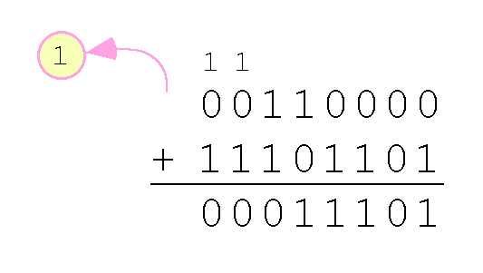
Signed Integer Representation
Two’s complement arithmetic
Add two binary numbers
Discard any carries
Example:
Using one’s complement binary arithmetic
Find sum of 48 and - 19
Note:
19 in one’s complement is: 00010011
-19 in one’s complement is: 11101100
-19 in two’s complement is: 11101101
Result: 29
Notes:
With two’s complement arithmetic, all we do is add our two binary numbers. Just discard any carries emitting from the high order bit.
Example: Using one’s complement binary arithmetic, find the sum of 48 and - 19.
We note that 19 in one’s complement is: 00010011, so -19 in one’s complement is: 11101100,
and -19 in two’s complement is: 11101101.
And our Result is still 29!

Slide 20
Signed Integer Representation
Finite number of bits to represent a number
Calculations may become too large for memory storage allotted
Can’t prevent overflow
Can detect overflow
Complement arithmetic
Overflow condition is easy to detect
Notes:
When we use any finite number of bits to represent a number, we always run the risk of the result of our calculations becoming too large to be stored in the computer.
While we can’t always prevent overflow, we can always detect overflow.
With complement arithmetic, an overflow condition is easy to detect

Slide 21
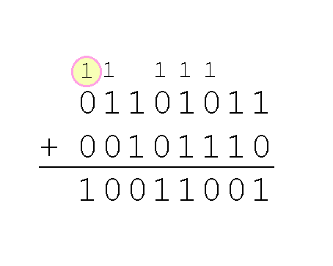
Signed Integer Representation
Example:
Using two’s complement binary arithmetic
Find sum of 107 and 46
Nonzero carry from seventh bit
overflows sign bit
erroneous result: 107 + 46 = -103
Rule for detecting signed two’s complement overflow:
When the “carry in” and the “carry out” of the sign bit differ
overflow has occurred.
Notes:
Example:
Using two’s complement binary arithmetic, find the sum of 107 and 46.
We see that the nonzero carry from the seventh bit overflows into the sign bit, giving us the erroneous result: 107 + 46 = -103.
Rule for detecting signed two’s complement overflow:
When the “carry in” and the “carry out” of the sign bit differ
overflow has occurred.
In this case the carry in was 1 and the carry out was 0

Slide 22
Signed Integer Representation
Signed and unsigned numbers are both useful
Memory addresses are always unsigned
Unsigned integers can express twice as many values as signed numbers
Adding one column adds power of 2
Unsigned value “wraps around” causes error
1111 + 1 = 0000
Good programmers stay alert for this kind of problem.
Notes:
Signed and unsigned numbers are both useful.
For example, memory addresses are always unsigned.
Using the same number of bits, unsigned integers can express twice as many values as signed numbers.
Remember adding one column or digit adds a power of 2
Trouble arises if an unsigned value “wraps around.”
In four bits: 1111 + 1 = 0000.
Good programmers stay alert for this kind of problem.

Slide 23
Signed Integer Representation
Overflow and carry are important in lower level programming
Signed number overflow means nothing in the context of unsigned numbers, which set a carry flag instead of an overflow flag.
If a carry out of the leftmost bit occurs with an unsigned number, overflow has occurred.
Carry and overflow occur independently of each other.
Notes:
Overflow and carry are different and are tricky ideas.
They will be very important as we begin doing arithmetic in assembly.
Signed number overflow means nothing in the context of unsigned numbers, which set a carry flag instead of an overflow flag.
If a carry out of the leftmost bit occurs with an unsigned number, overflow has occurred.
Carry and overflow occur independently of each other.
The table on the next slide summarizes these ideas.

Slide 24
Signed Integer Representation
Expression | Result | Carry? | Overflow? | Correct result
0100 (+4) + 0010 (+2) Signed magnitude | 0110 (+6) | No | No | Yes
0100 (+4) + 0110 (+6) Signed magnitude | 1010 (-6) | No | Yes | No
1100 (-4) + 1010 (-2) Signed magnitude | 1110 (-6) | Yes | No | Yes
1100 (-4) + 1010 (-6) Two’s Complement | 0110 (+6) | Yes | Yes | No
Notes:
Let’s study each of these examples which show the difference between carry & overflow.
The binary numbers are three digit value (octal) with a left most sign bit.
The first two are positive signed addition and in the first expression every works well and the result is correct. There is no carry and no overflow.
In the second expression the result of the addition overflows into the sign bit and causes an incorrect answer.
The third expression has two negative numbers represented with signed magnitude. In this example, when the two sign bits are added it generates a carry and 0 for the left most bit. However, according to the rules of signed magnitude addition, the sign bit for two negative numbers must be set to 1 after the addition is complete.
The fourth example has two numbers represented in two’s complement. When these are added they generate a carry. However, the “carry in” and the “carry out” of the sign bit also differ
so overflow has also occurred. Applying the rules for two’s complement addition, the overflow bit indicates that an error has occurred.
The processor will do as it is instructed and the program logic must determine which rules to apply, depending on the type of number representation it is adding.

